Slide 1


2025 Popcorn
Kick-off
AND MOON PIES!!

Slide 2


Slide 3
Calendar Review
July- 30TH
Unit Show and Sell Order Due
Unit Moon Pie Order Due

Slide 4
Calendar Review
August-
Product Pickup- 15th
(Enter Unit Show and sell Dates-Time-Locations here)

Slide 5
Calendar Review
September
(Enter Unit Show and sell Dates-Time-Locations here)
October
Show-N-Sell Returns – 22nd
Take Orders Due – 29th Enter (Units Due Date here)

Slide 6
Calendar Review
November
Take Order Pick Up – 14th (Enter Date parents can pick up take orders here)
December
Money and Prize Orders Due – 5th (Unit Deadline here)
5% loss of commission for late payments.

Slide 7
Who to Contact Three Rivers
District Popcorn Chair District Executive
Derek Gillespie Tammy Burek
706-483-5661 706-980-0375

Slide 8
Who to Contact Etowah
District Popcorn Chair District Executive
George Henington
850-491-2381

Slide 9
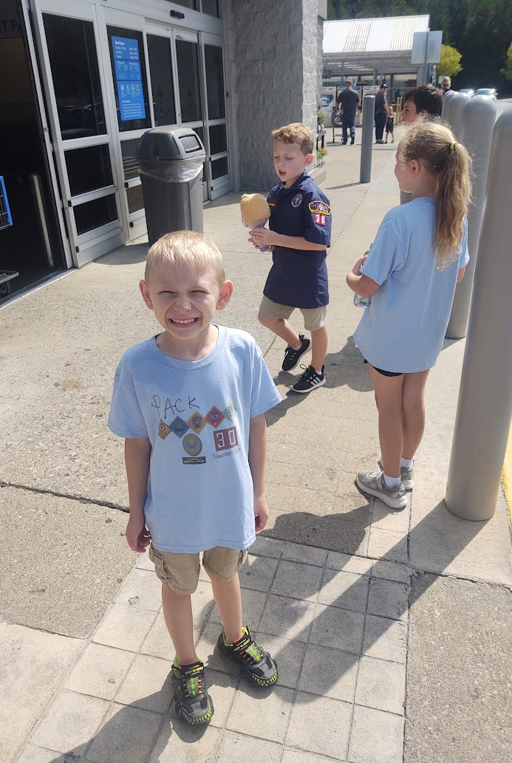
Selling Popcorn
What are some reasons what Cub Scouts sell a lot of popcorn?
Cute
Showing initiative for their age
They are doing their best
They exceed customer expectations

Slide 10
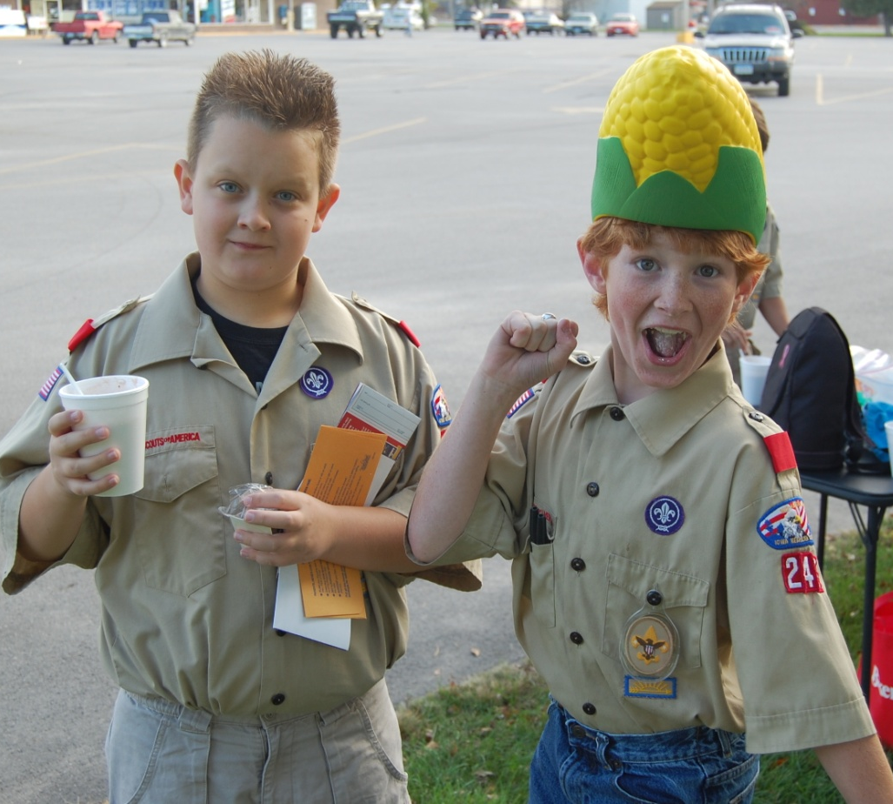
Selling Popcorn
Mistakes Scouts BSA make when selling popcorn.
Cute doesn’t work anymore
Same sales pitch doesn’t work
Not in full or clean uniform
They do not exceed customer expectations

Slide 11
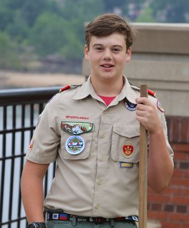
Selling Popcorn
What successful Scout BSA members do to sell popcorn.
Full, neat, and clean uniform
Has a well-prepared sales pitch
Knows their customers and their past orders
They exceed customer expectations

Slide 12
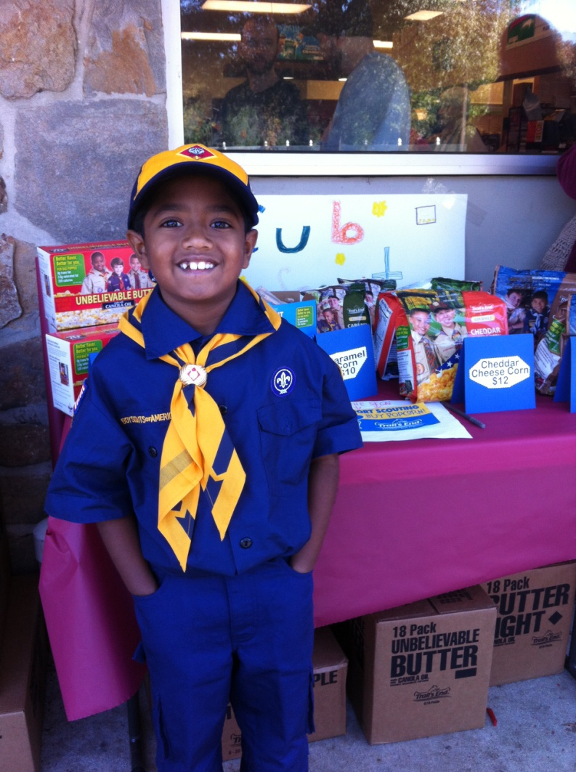
Show-N-Sell
Packs and Troops pre-order popcorn to sell
Units set up areas where they can have a display table and sell popcorn directly to customers

Slide 13
Show-N-Sell
Now is the time to confirm locations
Know your unit’s sales history for Show-N-Sell
Train your Scouts
Interact with customers, keep shifts short for the Scouts
Decide now how credit for Show-N-Sell will be done in your unit

Slide 14
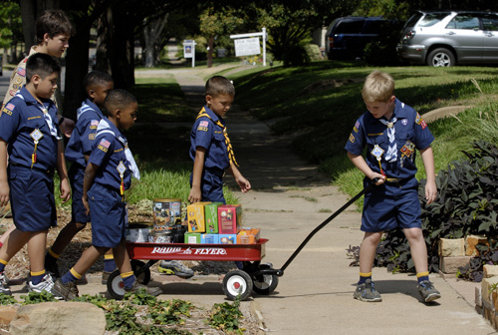
Show and Deliver
Packs and Troops pre-order popcorn to sell
Scouts take product around the neighborhood and sell door to door. Instead of taking orders they sell the product they have on hand.

Slide 15
Returns
October 22nd
Enter unit return deadline here
Unopened containers only
Containers must be undamaged
Returned to Enter persons name here
Units may choose to keep product for future store front sales.
Not all items eligible for returns.

Slide 16
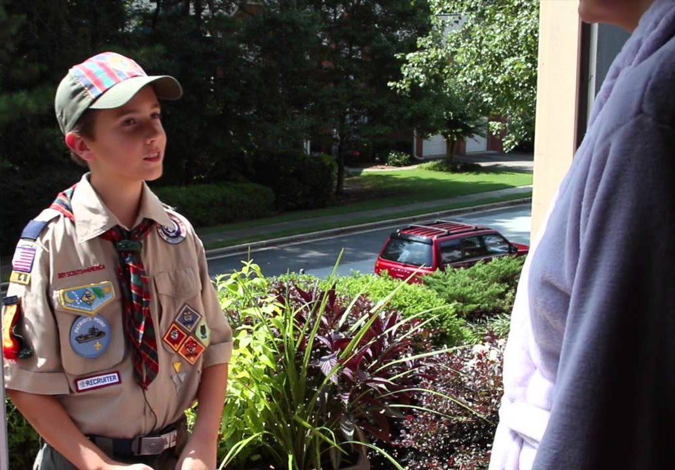
Take Order
Scouts and parents take orders from neighbors, friends, and family.

Slide 17
Take Order
If Scouts sold last year have them start with those they sold to.
Average $300 an hour in sales
Parents help sell
Use social media
Consider including your Chartered Partner
Take the money up front
Participate in the Homerun weekends

Slide 18

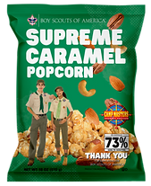
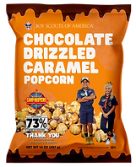
Product Line
03
0
Caramel Corn
$15
Supreme Caramel With APC
$25
Chocolatey Drizzled Caramel Crunch
$30

Slide 19
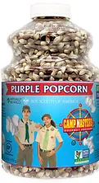

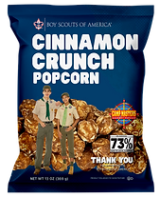
Product Line
03
0
Gourmet PURPLE Popping Corn
$15
White Cheddar Cheese
$20
Cinnamon Crunch Bag
$20

Slide 20
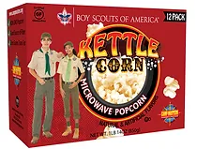
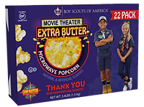
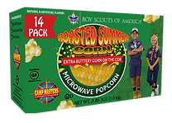
Product Line
Kettle Corn
12 Pack
$20
Movie Theater Butter
22 Pack
$30
Roasted Summer Corn
14 Pack
$20

Slide 21


Product Line
Military Donation
$50
Military Donation
$30

Slide 22


Slide 23
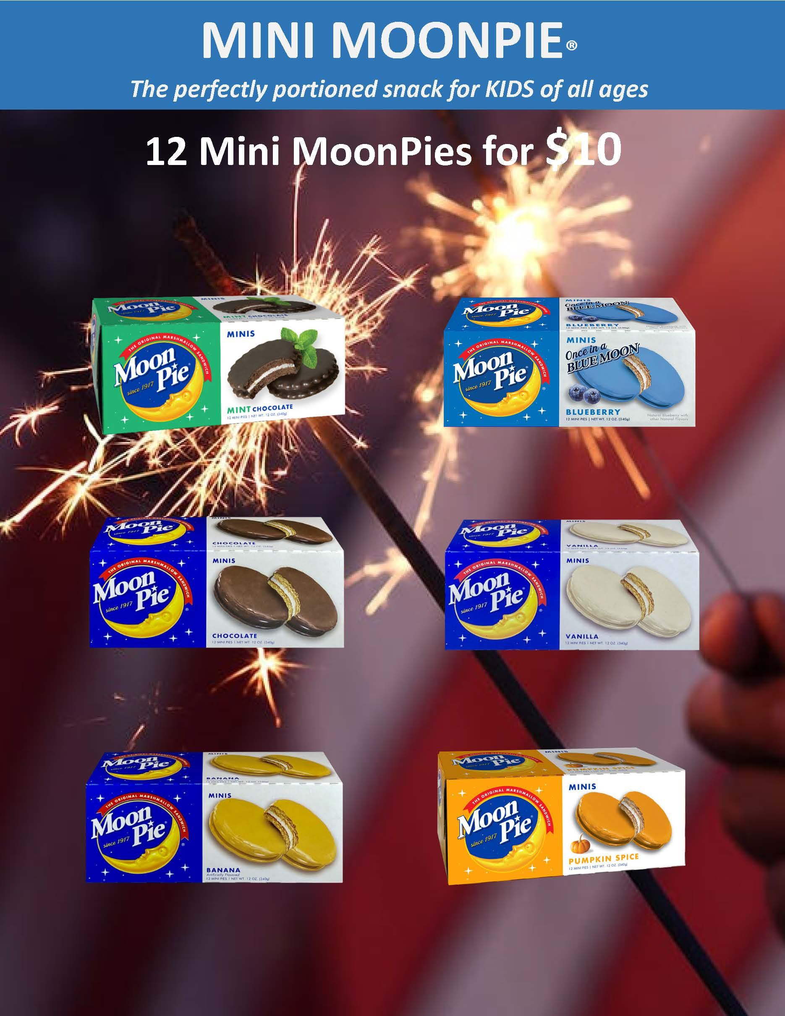
Product Line

Slide 24
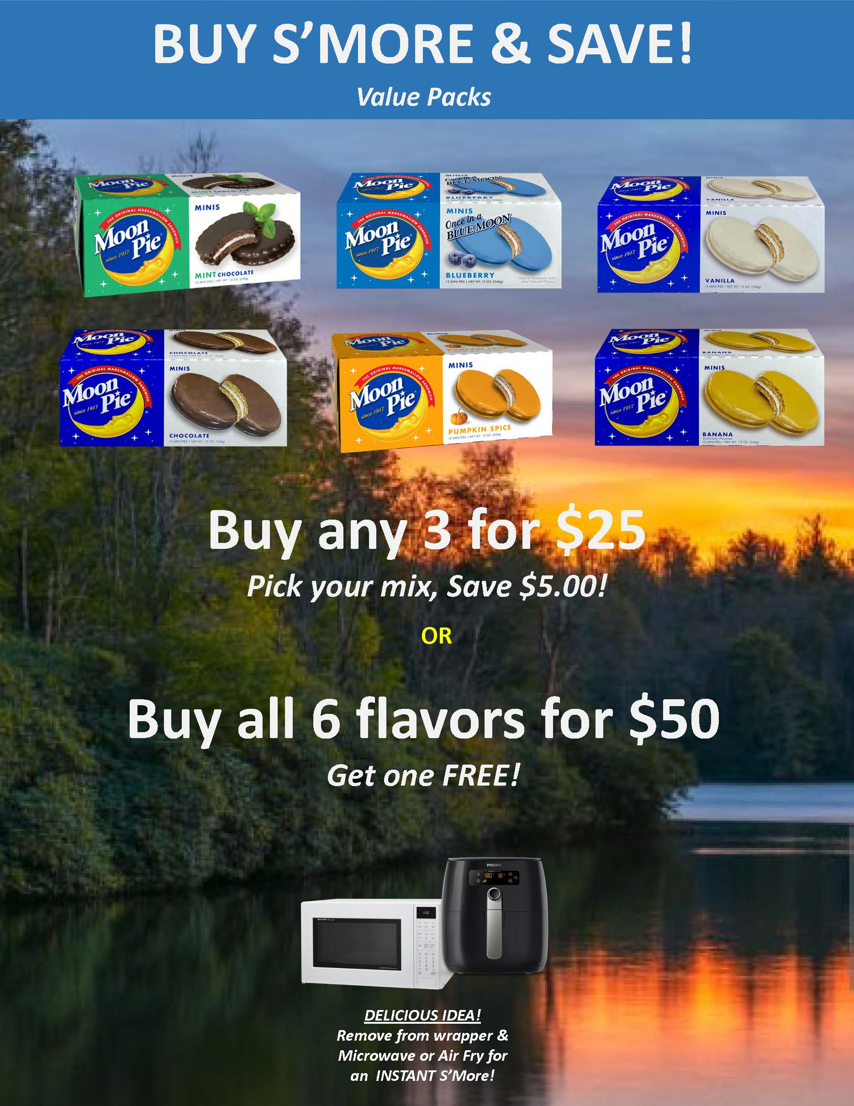

Slide 25


Slide 26
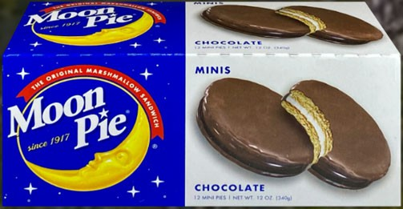
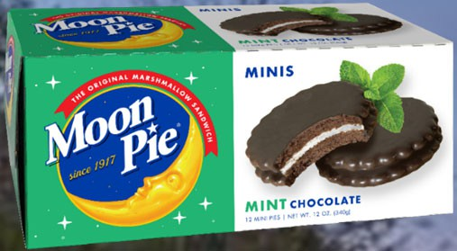
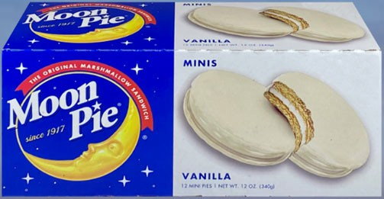
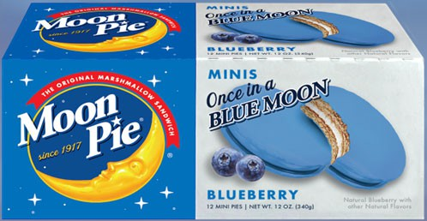
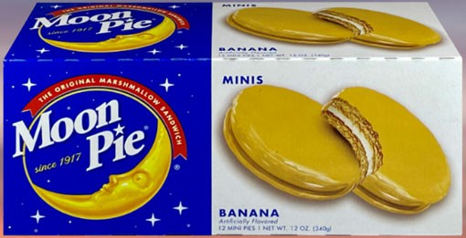
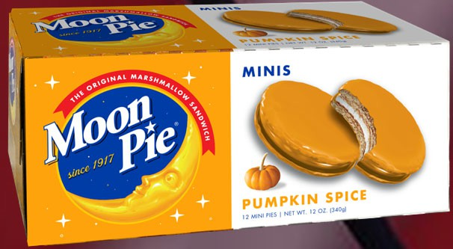
Moon Pie Prizes and Commission
Straight 40% Commission
Sales count towards prize levels.
Re-order more often.
No return

Slide 27
2025 Commission
40% Commission
Sell at least $8,000 or have a per Scout average of $450
35% Commission
Have a per Scout Average of $301 to $449
30% Commission
Have a per Scout Average under $150
33% Commission
Have a per Scout Average between $151 and $300
Based off June 30th number*

Slide 28
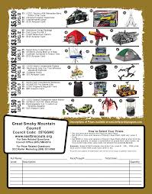
Prizes

Slide 29
Show-N-Sell Orders
Order by the CASE
Pre-ordered popcorn to sell at locations you set up
Double check the number of individual items that are in a case before ordering
Use leftovers to fill your Take-Order

Slide 30
Take Orders
Due October 29th (Enter Unit Due Date here)
Order by the CONTAINER
Use leftovers from Show-N-Sell to fill your orders first

Slide 31
Popcorn Payment and Prizes
Payment is due on or before December 5th (Enter Unit Due Date Here)

Slide 32
Unit Potential
An average unit of 20 Scouts
Average sale per Scout is $600
  That’s about three hours of neighborhood sales or about four hours of Show-N-Sell
Gross sale of $12,000
Unit Commission $4,800 ($240 per Scout)

Slide 33


